Slide 1
People Analytics Case Study
December 2021

Slide 2

Agenda – Gas Engineering
1
2020 Gas Engineering Overview
Application Types
Overview
Candidate Source
2
2020 Gas Engineering Pass Through Rates
3
2020 Gas Engineering Resource Plan
2021 Outlook
Business Risks & Additional Information

Slide 3
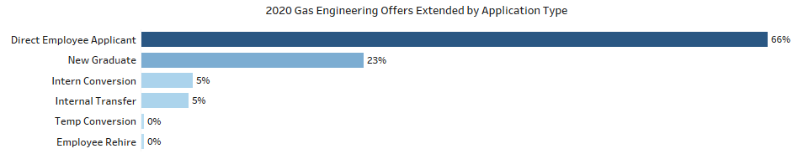
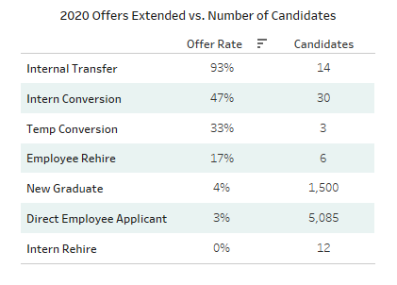
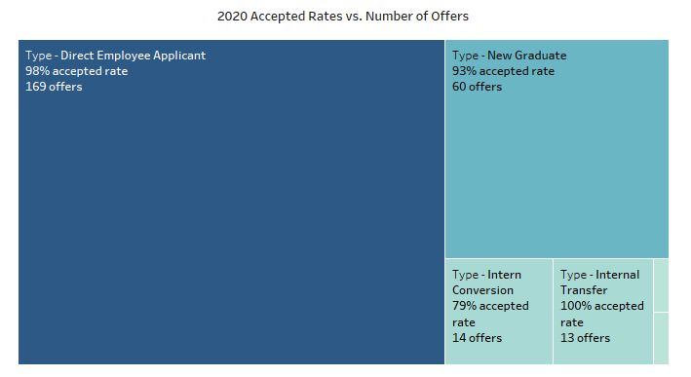
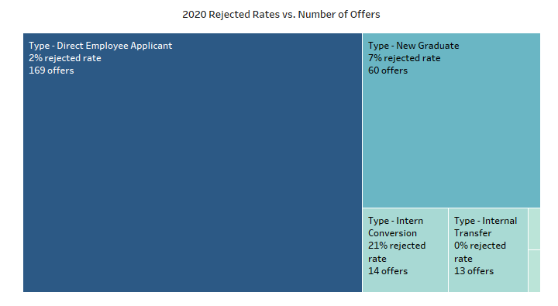
2020 Gas Engineering Overview
Application Types
*offer rates are normalized and calculated with affective sample population for application type candidate pool
Direct Employee Applicants are 66% of the total “Offers Extended” in 2020.
Those offers were extended at a rate of only 3% in relation to the total number of applicants.
Direct Employee Applicant candidate pool is a significant resource commitment as there is no Application Process.
Direct Employee Applicants account for 67% of total “Offers Accepted” in 2020
The rate in which offers are accepted in relation to the number of offers extended, Direct Employee Applicants lead other application types at a rate of 98%.
It will be crucial to look further into why the extended offers for Direct Employee Applicant candidates remain conservative and the acceptance rate high.

Slide 4
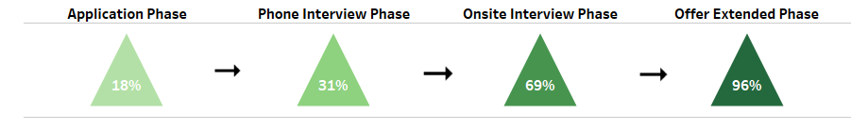
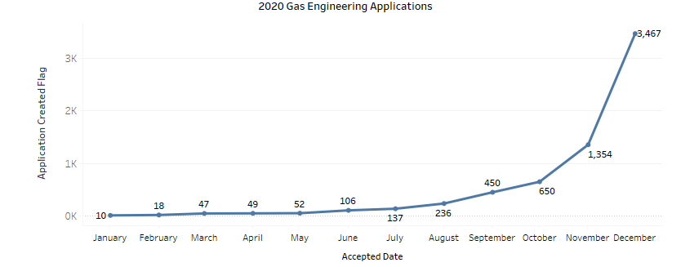
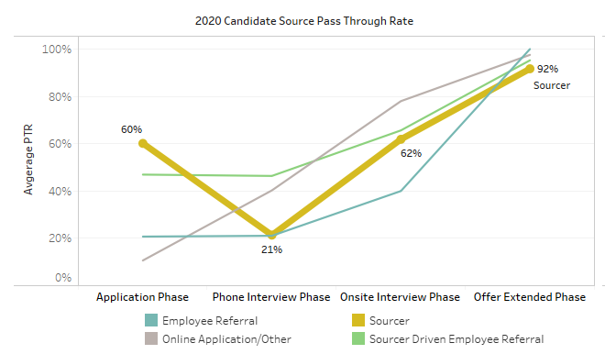
2020 Gas Engineering Pass Through Rates
Overview
Overall, the Gas Engineering candidate pipeline is healthy.
Pass through rates throughout the candidate pipeline exit each phase at an upward slope. The Offer’s Extended PTR is exceptionally high at 96% which shows that an affective candidate pool is being extended offers.
At 18%, The PTR for the Application Phase is relatively low and further scrutinization of the applicant pool and recruiting capacity should be performed.
It is crucial to understand the effectiveness of our recruitment methods, i.e job postings, sourcing, etc.
See next slide for additional comments on recruiting capacity.
All application type candidate pools on average maintain a high Offer Extended PTR.
Application type, Sourcer shows visible signs of bottleneck in the Phone Interview Phase.
As seen in the graph on the left, only 21% of the candidate pool exits the Phone Interview Phase and 60% of the candidate pool transitions from the Application process into Phone Interview process.
Further scrutiny is needed to identify if affective screening methods are taking place in the Application Phase for the Sourcer application type candidates

Slide 5
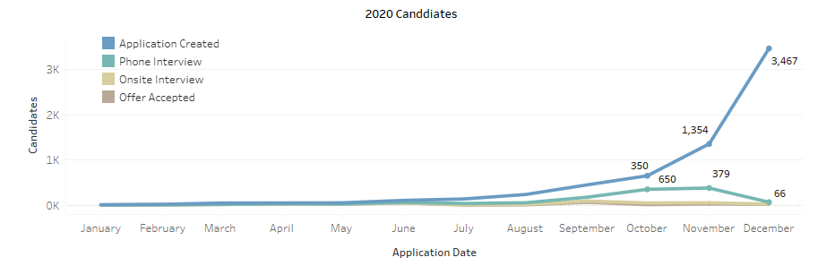
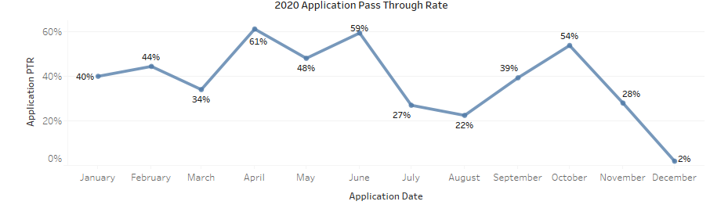
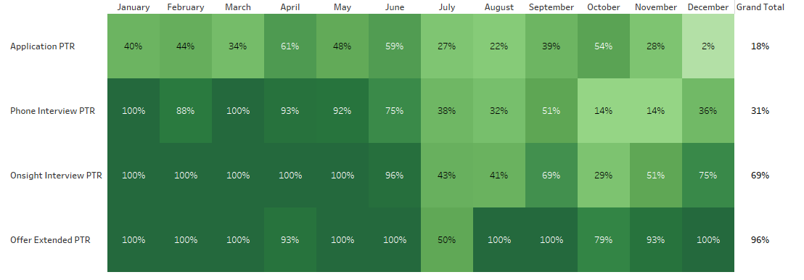
2020 Gas Engineering Resource Plan
2021 Outlook
As seen circled in blue, a dramatic increase in applicants in the 4th quarter of 2020 resulted in a relative decline in the Application PTR. We can assume the 4th quarter is primarily responsible for the exceedingly low Application PTR in 2020.
We can expect similar affects to the Application PTR as we take directed steps to impact hiring and set growth targets.

Slide 6
2020 Gas Engineering Resource Plan
2021 Outlook
Assumptions...
Target | 100 engineers
Time | 6 months
Capacity per recr. | 3 hires
Recruiters | 12 employees
Month | Application Phase | Phone Interview Phase | Onsight Interview Phase | Offer Extended Phase | Candidates | Recruiters | % of Target Complete
January | 81 | 25 | 17 | 17 | 83 | 6 | 17%
February | 81 | 25 | 17 | 17 | 67 | 6 | 33%
March | 81 | 25 | 17 | 17 | 50 | 6 | 50%
April | 81 | 25 | 17 | 17 | 33 | 6 | 67%
May | 81 | 25 | 17 | 17 | 17 | 6 | 83%
June | 81 | 25 | 17 | 17 | 0 | 6 | 100%
Capacity per month/ recr. | 36 hires
Target per month | 17 hires
Net hires | 19 hires
Recruiter surplus | 6 recruiters
Application
Phone Int.
Onsight int.
Offer Ext.
*450 Candidates
25 Candidates
18%
31%
17 Candidates
69%
17 Candidates
96%
At our current pass-through rates, we expect the target 100 Gas Engineer accepted offers to be completed by the end of June 2021 or in 6 months. Our analysis took a simple algebraic approach and assumes with a target of 100 hires and a timeline of 6 months we expect 17 (100/6) accepted offers per month.
We currently have 12 recruiters and each recruiter has a capacity of 3 hires per month. With a total capacity of 36(12*3) hires per month we are over resourced and will only need 6(12-((36-17)/3) recruiters to complete our hiring target.
We assume it is best to reduce the resources working on the hiring target as the Talent Acquisition team will need additional resources to meet companywide hiring expectations.
With no more than 17 extended offers per month from January – June 2021 and a combined capacity of 18(6*3) hires per month from our 6 recruiters we expect to be fully resourced.
We assume 450 candidates will enter the candidate pipeline per month and our 6 recruiters will be able to handle the influx.
As seen in the two graphs on the previous slide, as hiring increases in the months of October and November the Application PTR does not regress below 18% until the month of December and at this point the applicant pool is well above 450 candidates. Even with the reduction in total resources we expect to meet our hiring target.
Notes:
Minimum maximum time span

Slide 7
2020 Gas Engineering Resource Plan
Business Risks & Additional Information
Potential Business Risks:
Applicant shortage – Scrutinizing the 2020 applicant pool and relative volume fluctuations by month, the first three quarters of the year show a low number of Gas Engineering applicants. In order to meet our hiring target, it is crucial that the first half of the year continue to introduce a minimum of 450 candidates into our candidate pipeline.(COVID-19 may be the cause)
COVID-19 variant/ Omicron – The COVID-19 pandemic has shown to be significantly impactful to the labor market. Labor force participation, talent mobility, and growth targets will all be impacted by surges in COVID-19 infection rates and potential variants.(Omicron)
Reduction in labor force participation – According to the bureau of labor statistics, labor participation rates have drastically dropped in 2020 and are slow to rebound.
Heightened resource demand from other parts of the business – As we aggressively set our hiring target our model shows we must maintain 6 recruiters in the first 2 quarters of 2021 therefore to manage resources and overall hiring capacity it is important to understand company-wide resource and hiring demand.
Additional Information Required:
Historical candidate reports – utilizing historical candidate reports, or raw candidate files from previous years(2018;2019) we can better estimate and predict resource constraints at each phase of the candidate pipeline.(Application PTR)
Company-wide resource demand – we need at least 6 recruiters for our model to be affective. We would not meet our hiring target if there is a reduction in the number of recruiters. It is important to understand routine demand outside of our hiring target to affectively plan for resource capacity.
Talent Mobility Forecasts – A hiring target of 100 Gas Engineers is our hiring target but not the expectation for net headcount at the end Q2, 2021. It is important to adjust for talent mobility(attrition, transfers, promotions, etc) as we set hiring targets.

